Slide 1
Amarnath Venkataramanan MSc in Financial Technology

Slide 2
Process flow
Raw data
(Data acquisition)
Data Exploration
(Understanding of data)
Data Cleaning
(Treating missing values, Treating outliers and incorrect data)
Data visualization
(Learning data via graphical representation)
Model Evaluation
(Applying and evaluating model)
Inferring insights
(Interpreting hidden data information)

Slide 3
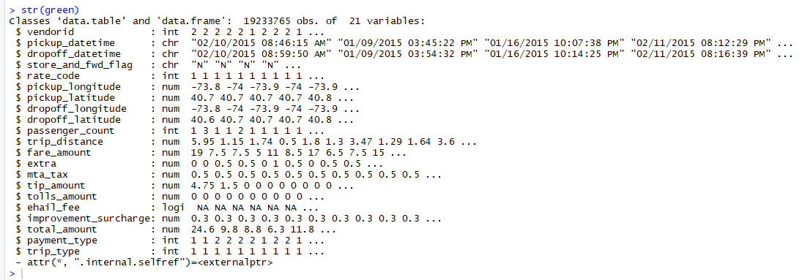
Do you know?
It is illegal for some taxis to pick-up passengers who hails on the new York city’s road-side.
Data Exploration
Data source: https://data.cityofnewyork.us/Transportation/2015-Green-Taxi-Trip-Data/gi8d-wdg5/about
Structure of dataset:

Slide 4
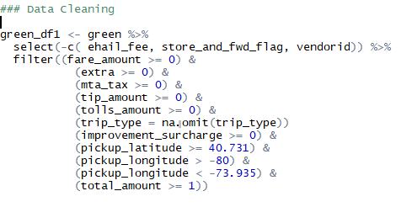
Data cleaning - 1
Before transformation
The feature Ehail_fee of the dataset doesn’t have any value.
Pickup location and drop location are beyond New York city.
There are 72 missing values in the Trip_type feature of the dataset.
The features Fare amount, Tip amount, Improvement surcharge, MTA tax and Total amount have negative values.
Data cleaning process
After transformation
The transformed dataset doesn’t have features like vendorid, ehail_fee and store_and_fwd_flag.
Pickup location and drop location are within New York city.
There are no missing values in the dataset.
There are no negative values in any of the features of the dataset.

Slide 5
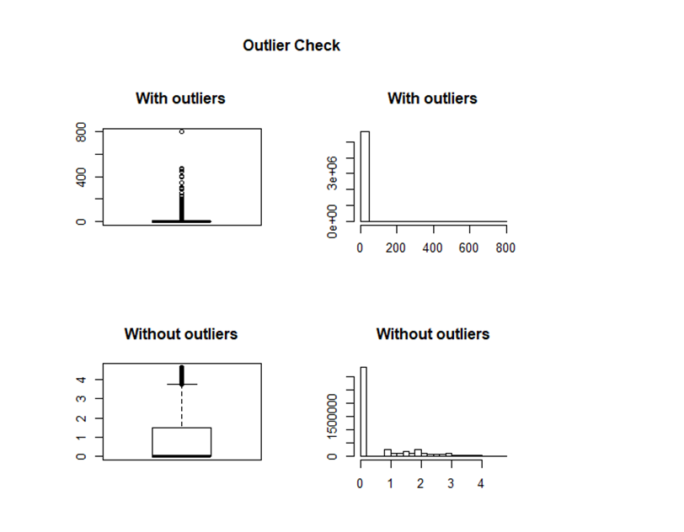
Data cleaning – 2 (Treating Outliers of Tip_amount feature)

Slide 6
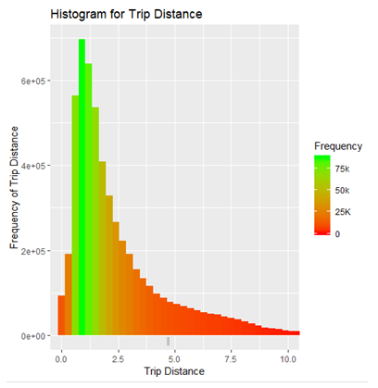
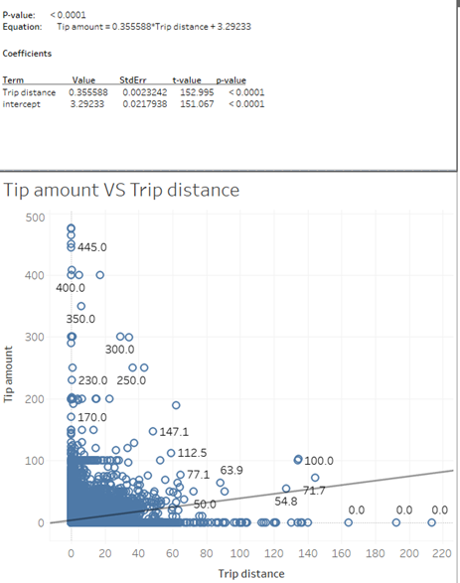
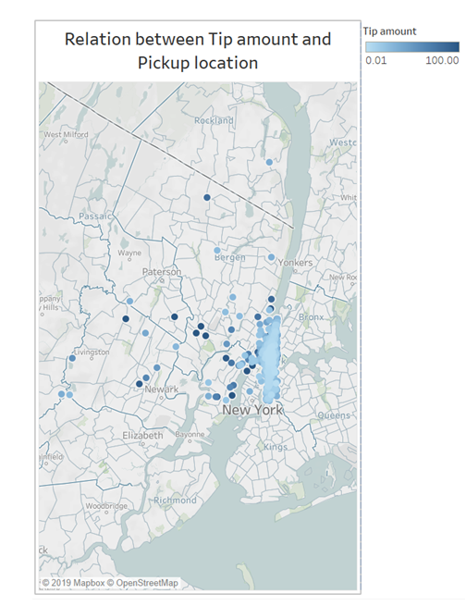
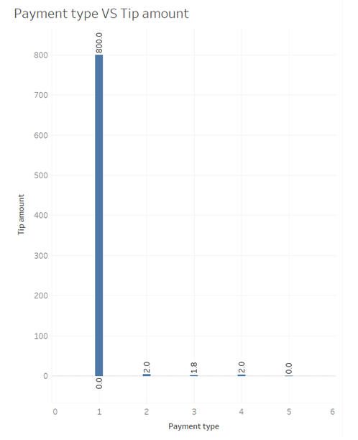
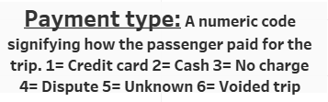
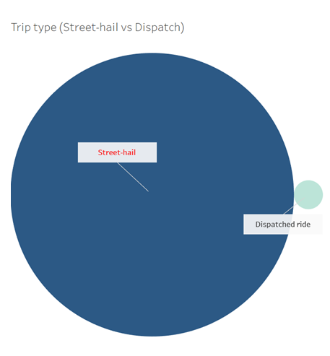
Data Visualization

Slide 7
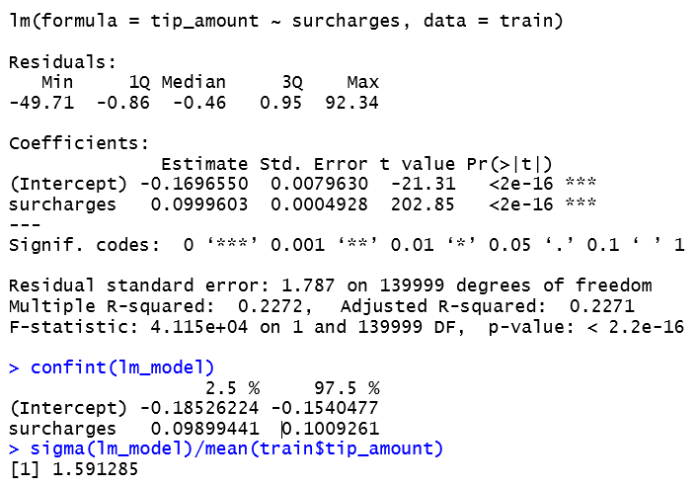
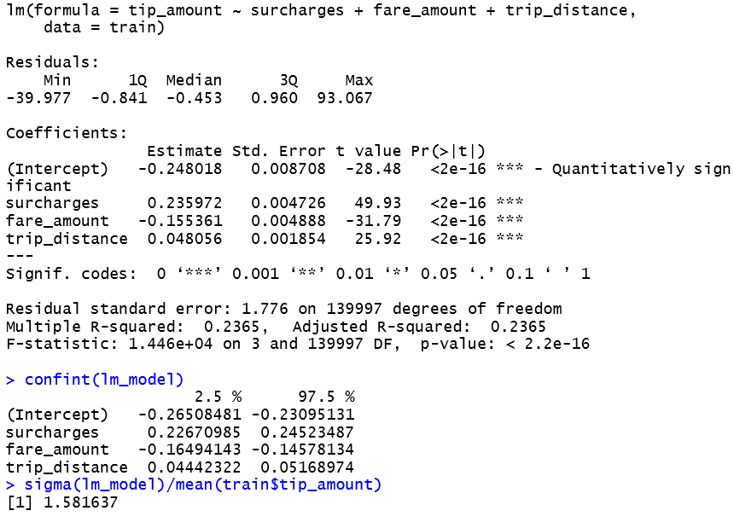
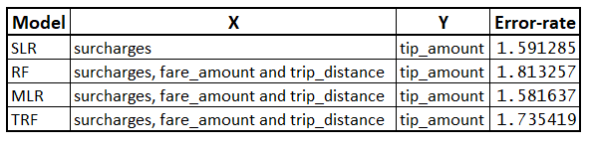
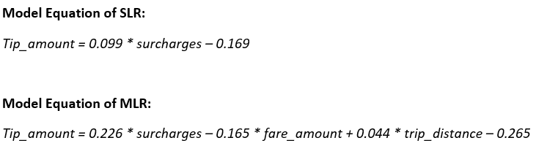
Model Evaluation
Simple linear regression
Random Forest
Multi linear regression
Tuned Random forest

Slide 8
Insights
Following are the insights obtained via regression analysis and plots,
As per the outcome of the best model, tip_amount changes in the same direction as per the changes in surcharges and trip_distance whereas tip_amount changes in the opposite direction to change in the fare_amount.
But some set of customers paying tips irrespective of other factors like surcharges and fare_charges.
Most of the customers are paying fare using credit card which says that continuous connectivity is must.
Street hails are found to be high in number than other source of booking taxi which says that green taxi must introduce other way of booking like mobile apps to face the rivals like.
Frequent of trips is high in city centre but likelihood of getting higher tips is found to be low and the situation is vice versa in the places around city centre.
Mostly the probability of obtaining tips is high from shorter trips and also most of the trips are found to be shorter so taxi drivers found to be preferring short trips than longer trips.

Slide 9
Limitations
Following are the limitations identified in this analysis,
Linear regression could not explain variance in the dependent variable which may be improved by adding more relevant independent variables.
This analysis doesn’t consider external factors like climate and other taxi types like yellow cabs, black cabs, Uber and Lyft which have capability to affect the outcome of this analysis in a drastic manner.

